Slide 1
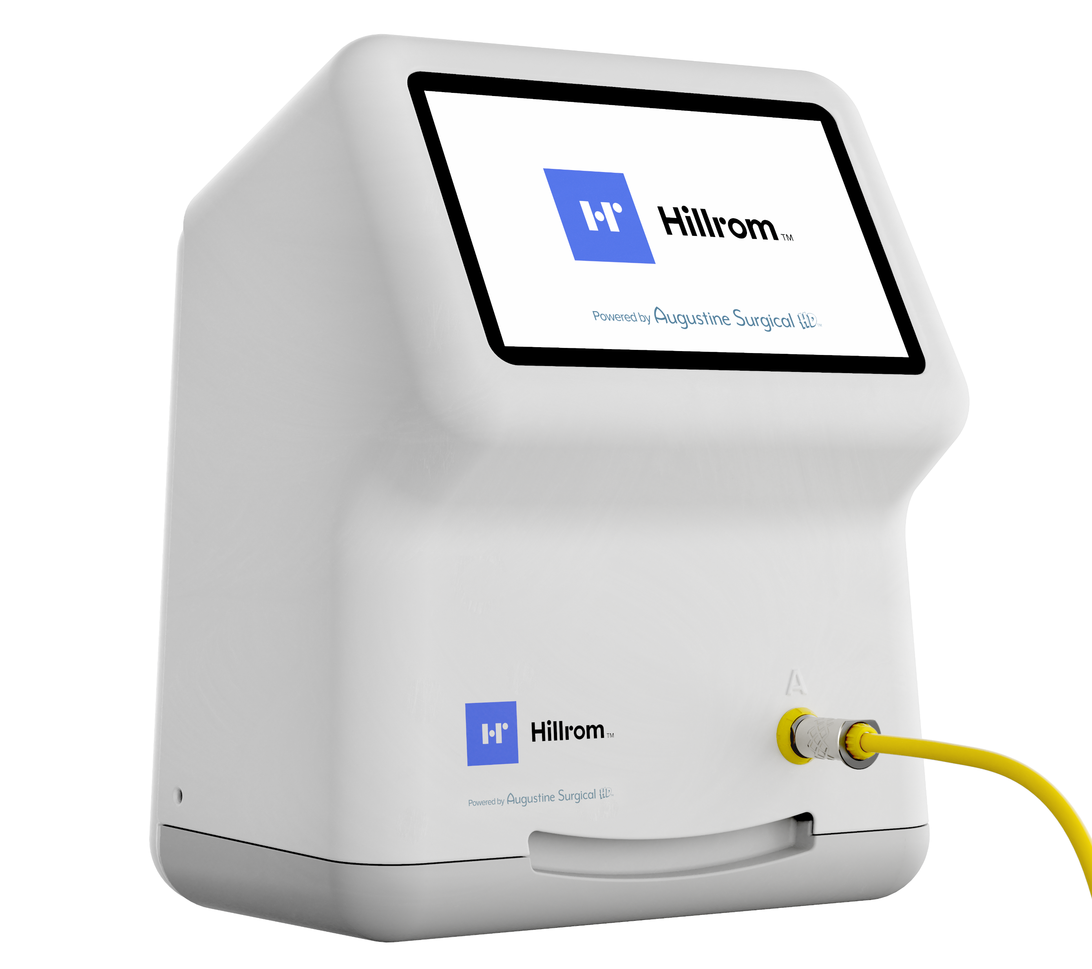

Slide 2
Temperature Management Controller MP
Physical Characteristics
Dimensions (H x D x W) | 11” x 7” x 8.75” (28 cm x 17.8 cm x 22.2 cm)
Weight | 6.3 – 8.3 lb without the clamp or cables (2.85 - 3.75 kg)
Mounting | Can be placed on a horizontal flat surface (i.e. tabletop), clamped to an IV pole, or hung using a VESA mount of either FDMI MIS-C (35 × 75 mm) or FDMI MIS-D (75 × 75 mm) specifications
Temperature Characteristics
Temperature Control | Micro-processor
Operating Temperatures | Blanket Ports A, B, C, and D adjustable in 1°C increments 98.6° to 109.4° ± 1.8°F (37° to 43° ± 1.0°C)
 | Mattress Port M adjustable in 1°C increments 95° to 104° ± 1.8°F (35° to 40° ± 1.0°C)
Electrical Characteristics
Leakage Current | Meets UL 60601-1 and IEC 60601-1 requirements for Class I, Type BF equipment.
Power Consumption | 850W maximum
Power Cord | 15 ft (4.6 m); May vary by country and region per local requirements and regulations.
Device Ratings | Input: 100-240 VAC, 50/60 Hz, 850VA Output A, B, C, D: 48 VDC, 480 VA Max each Output M: 336 VA Max
Fuses | T10AL250V (2 x 5 x 20 mm)
1

Slide 3
Temperature Management Controller MP
Environmental Conditions
Environmental Conditions for Transport and Storage | Temperature: -20°C to 60°C Humidity: 20% to 80% Keep Dry
Environmental Conditions for Use | Temperature: 15°C to 25°C Humidity: 20% to 80%
Classification & Standards
Certifications | IEC 60601-1; EN 60601-1-2; UL 60601-1; CAN/CSA-C22.2, No. 601.1, EN 55011
Classification | Classified under IEC 60601-1 Guidelines (and other national versions of the Guidelines) as Class I, Type BF, Ordinary equipment, Continuous operation. Not suitable for use in presence of flammable anesthetic mixtures with air or with oxygen or nitrous oxide. Classified by Intertek Testing Services NA Inc. with respect to electric shock, fire, and mechanical hazards only, in accordance with UL 60601-1. Classified under the Canadian Medical Device Regulation as Class II.
Diagnostics | A qualified technician can perform general system testing. The Controller has no user serviceable parts.
2

Slide 4
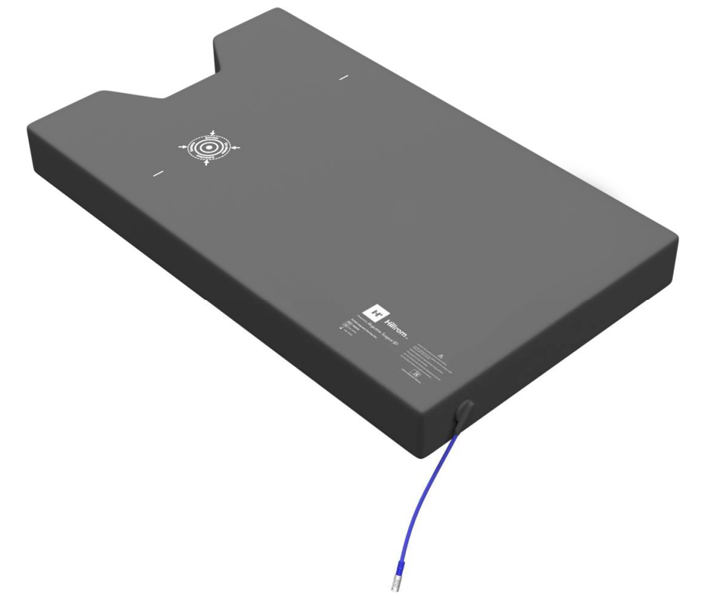
TS7000 Integrated Warming Pad and PST 500 Integrated Warming Pad
Physical Characteristics
Dimensions (L x W) | TS7000 Integrated Warming Pad: 45” x 21.5” (1143 mm x 545 mm)
 | PST 500 Integrated Warming Pad: 42.3” x 21.5” (1075 mm x 545 mm)
3

Slide 5
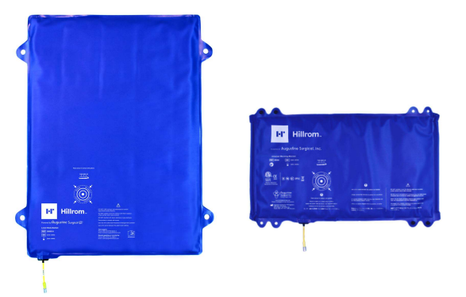
Lower Body Blanket and Universal Warming Blanket
Physical Characteristics
Dimensions (L x W) | Lower Body Blanket: 29.5” x 38.7” (749 mm x 984 mm)
 | Universal Warming Blanket: 17” x 30” (432 mm x 762 mm)
4

